Slide 1
A Context Lake holds the reviewed meaning across an enterprise's systems.
Policy
Context Lake
Reviewed meaning in the
Lake Card
Each source system keeps its own records. The lake card is the reviewed meaning those records do not hold.
Program
Recorded decision
Lake card
One reviewed fact: the statement, who accepted it, the source, and the dates it applied. A later reader can point at that meaning.
Rule card
The decision table for one rule: the inputs, the authority, and the tests. So every reader applies that rule the same way. If the table is missing, the result names that missing card.
Knowledge graph
Links between cards: carries out, governs, conflicts with, replaces, evidenced by, depends on, maps to, and tested by. A reader walks from a rule to the program, the decision, and the evidence.
Shared words
One definition, plus the local names other systems use for that word. Systems that use different words can still meet on one meaning.
Review gate
A fact enters only when it has an owner, a legal shape, and links that point at real cards. Raw operational rows stay in the system that owns them.
Built copy
One read-only file from the reviewed source, so every reader sees the same set. A change starts in the source, then a new copy is built.
An enterprise keeps many systems, and each system keeps its own records. Together, these six parts give every team the same accepted meaning, the same owner, and the same links.
The lake does not take over the systems that still run the work.
Force Fab
1
Notes:
A Context Lake holds the reviewed meaning across an enterprise's systems. A lake card is one reviewed fact a later reader can point at. A rule card is the decision table for one rule, so the same rule is applied the same way and a missing table is visible. The knowledge graph is the links between cards, so a reader can walk from a rule to the program, the decision, and the evidence. Shared words give one definition and the local names other systems use. The review gate lets a fact in only when it has an owner, a legal shape, and real links. The built copy is one read-only file, so every reader sees the same set. A change starts in the source, then a new copy is built. Together, these six parts give every team the same accepted meaning, the same owner, and the same links. The lake does not take over the systems that still run the work.
Point at the six parts, then the gold line.
Next slide: this page on a semiconductor lot.

Slide 2
Context Lake : Recipe Mismatch Scenario
Lot L00000016 shows dispatch recipe R02 and tool recipe R01. That row does not say what the disagreement means, who accepted the rule, or which program carries it out.
Those facts started in the policy record, the old programs, and the locked decision. They are not on the traveler.
The Context Lake is the reviewed page that ties those facts together, so the command center can point at the accepted rule instead of guessing from the two recipe fields.
Keep the wafer decision available
Make a drifted rule visible
Application A
Application B
The rebuilt program still sets the hold if the page is missing. The page is what the signer reads. A missing page leaves the sentence with nothing to cite. The hold can remain, and RT-03 still signs. A knowledge file must not be what releases the lot.
The same page is the mark. If the page is missing or says something else, the mark changes and names that page. A rule that lives only in code can hide a missing written limit
One lake file, version 1.0.0, built 18 October 2026. It does not refresh as the lot moves. The model does not write the hold.
Force Fab
2
Notes:
The lot row cannot explain the hold. A reviewed rule page can. Lot L00000016 shows dispatch recipe R02 and tool recipe R01. The Context Lake ties the policy record, the old programs, and the locked decision into one reviewed page. Application A keeps the wafer decision available. The rebuilt program still sets the hold if the page is missing. The page is what the signer reads, and RT-03 still signs. A knowledge file must not be what releases the lot. Application B makes a drifted rule visible. The same page is the mark. A missing or different page changes the mark and names that page. A rule that lives only in code can hide a missing written limit, such as the old 1.05 tolerance. One lake file, version 1.0.0, built 18 October 2026, does not refresh as the lot moves. The model does not write the hold.
Point at the lot row, then the two cards.
Next slide: the command-center walk of this lot.

Slide 3
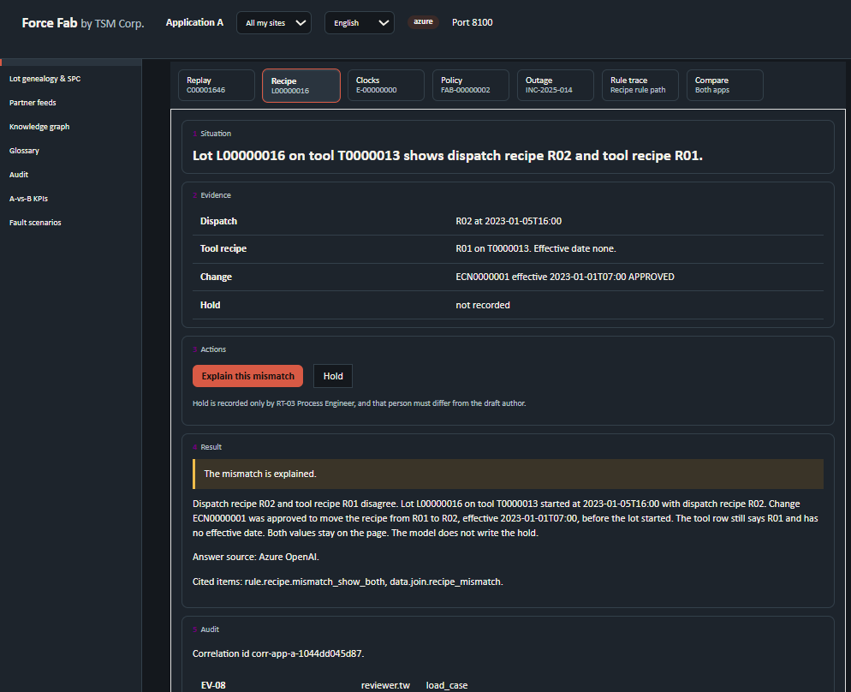
App A

Slide 4
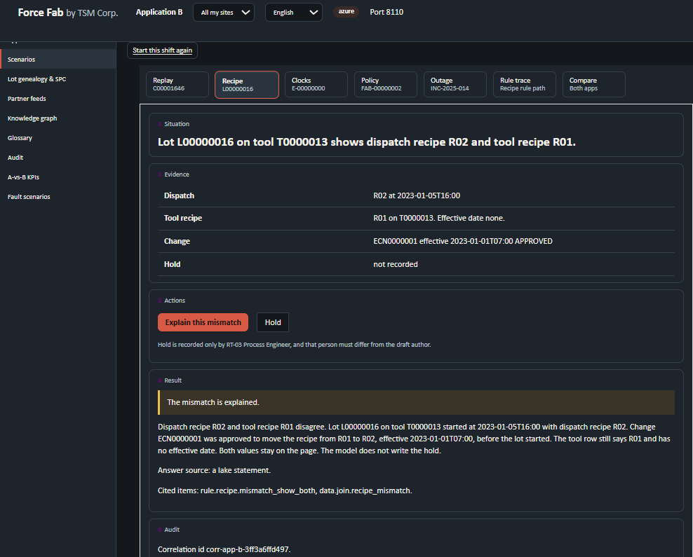
App B

